Slide 1
Background and Literature review

Slide 2
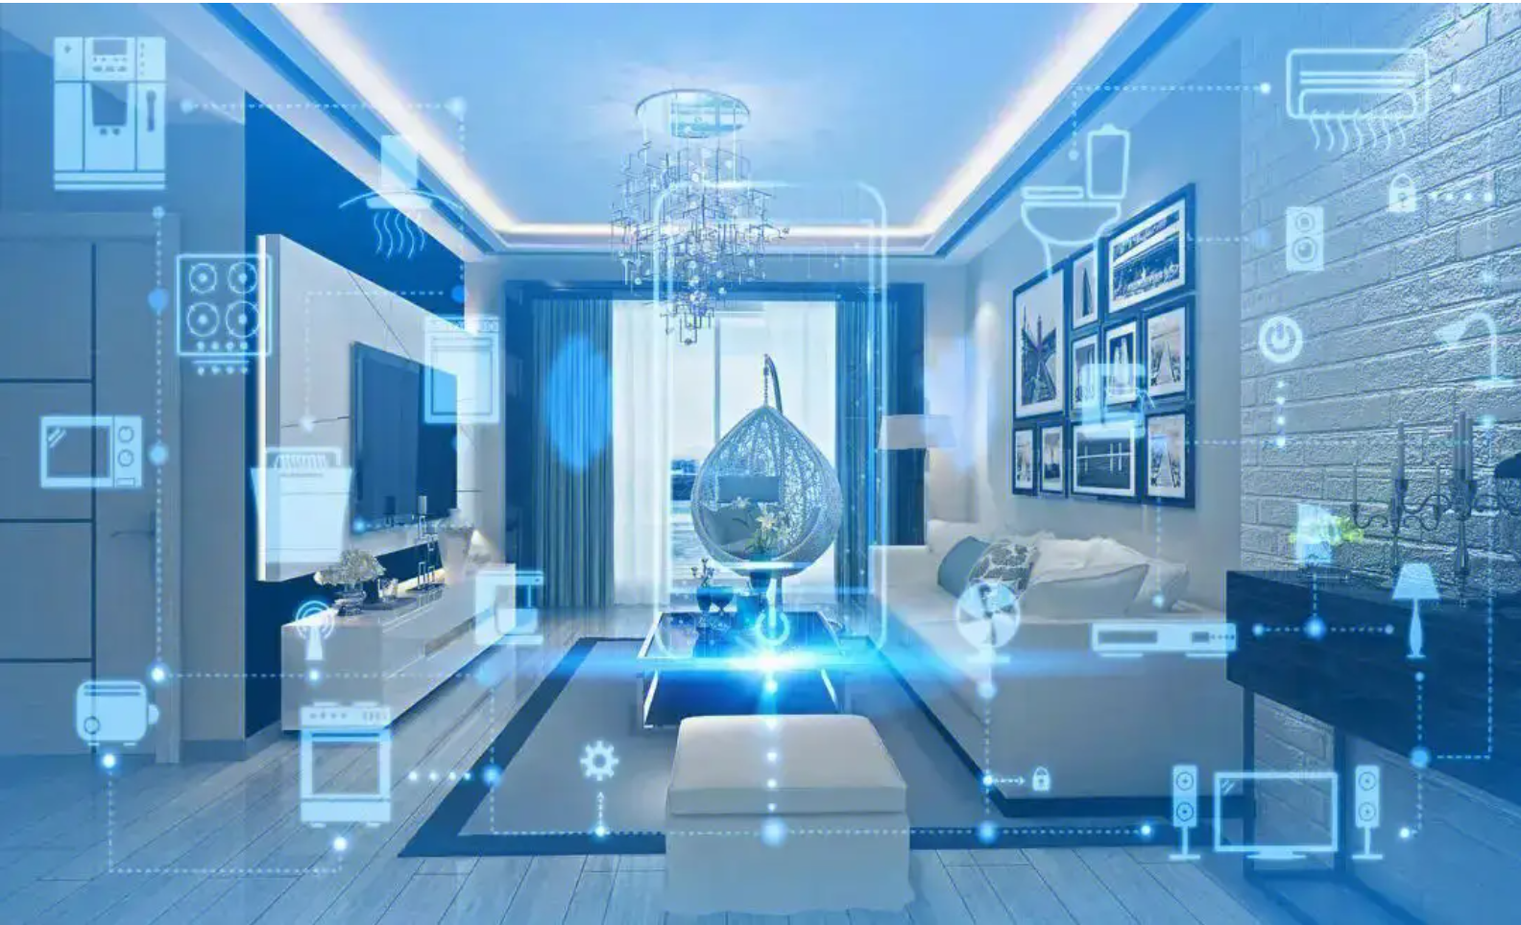

Background
Control everything without touching
Smart homes
Virtual gaming

Slide 3
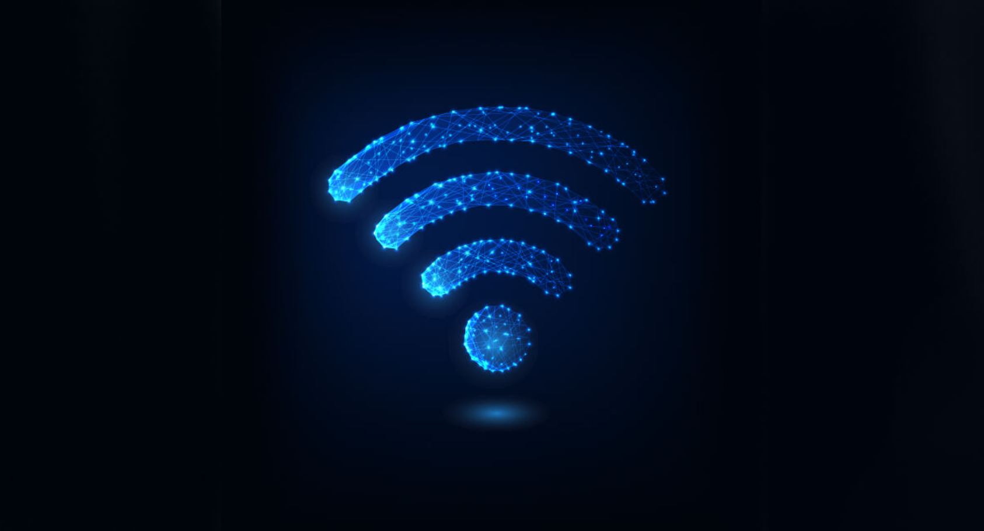
Background
Analyzing the changes in the Wi-Fi signal caused by the movement of a person's hand or body to interact with devices without physically touching them.
Wi-Fi Gesture Recognition

Slide 4
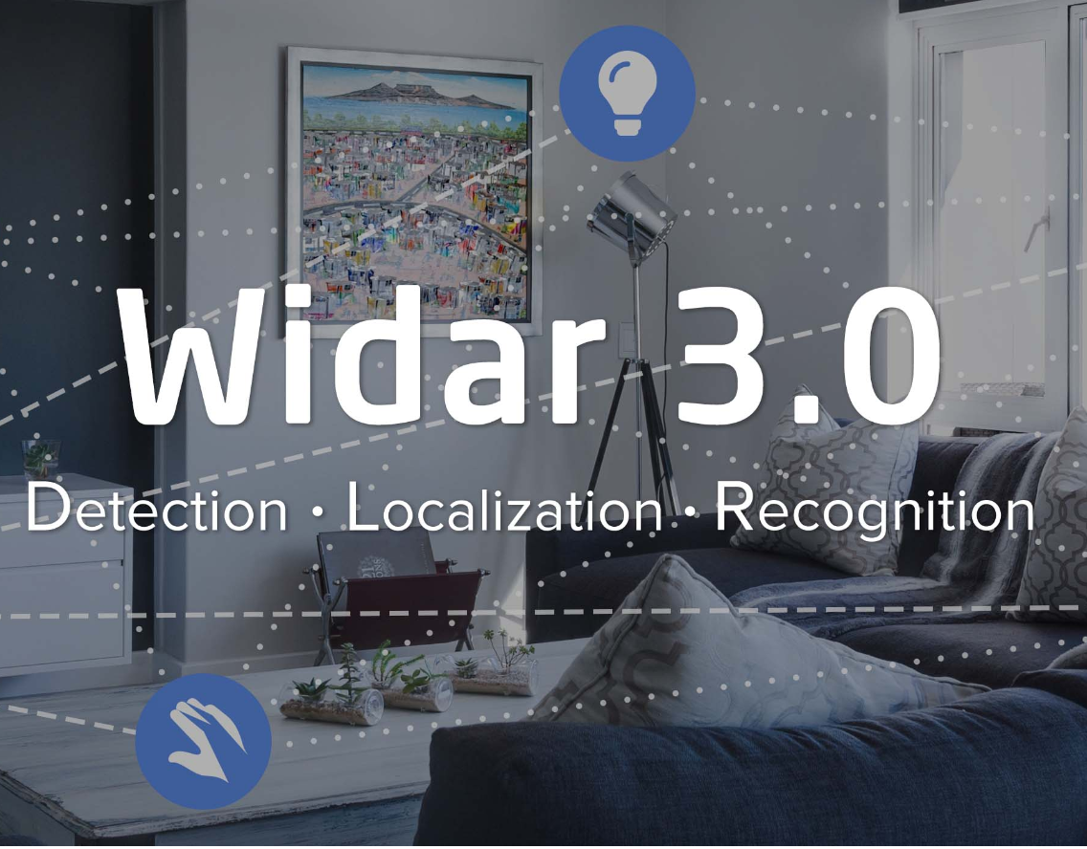
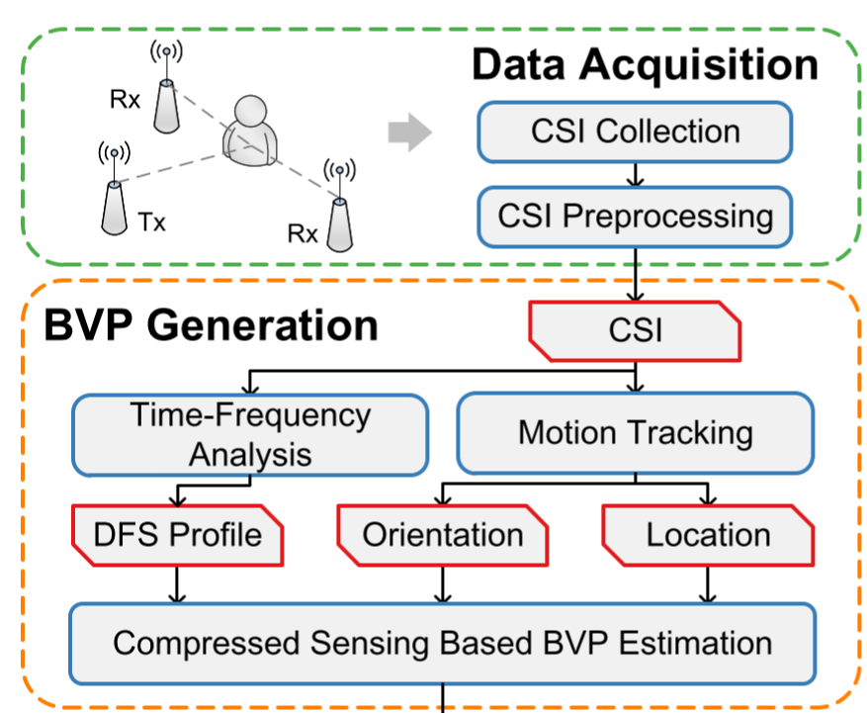
Background
Zero-effort cross-domain gesture recognition system via Wi-Fi, a fundamental step towards ubiquitous sensing
Data Processing

Slide 5
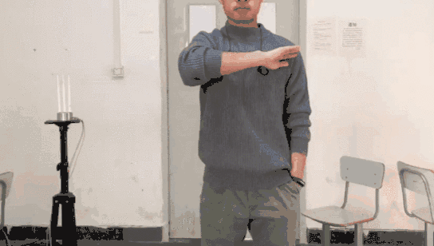
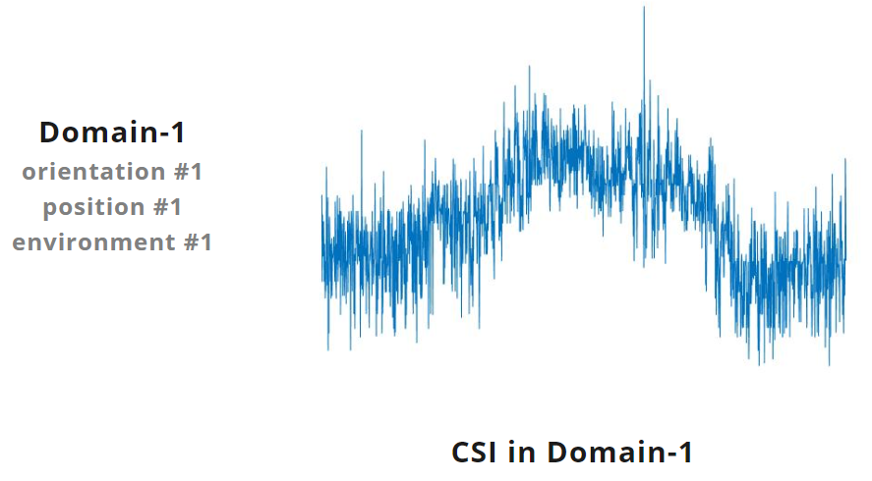
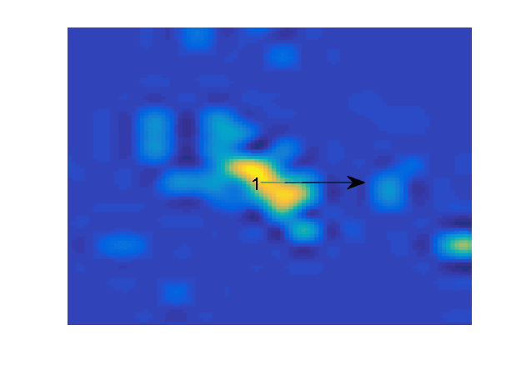
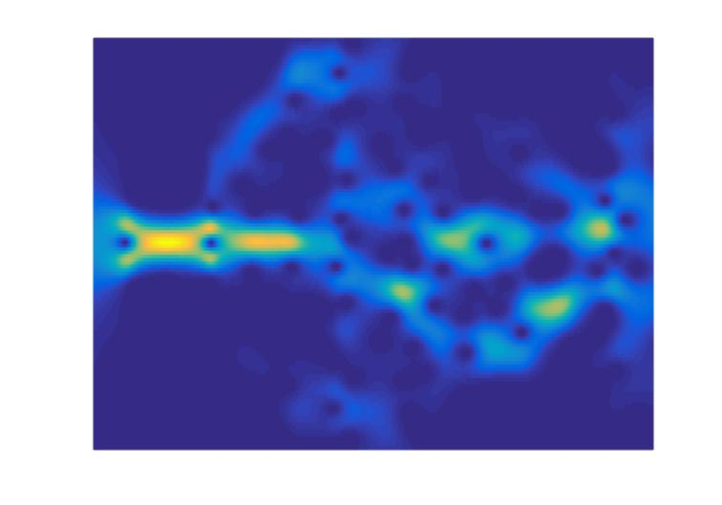
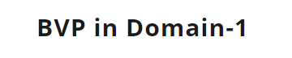
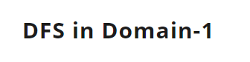
Sweep

Slide 6
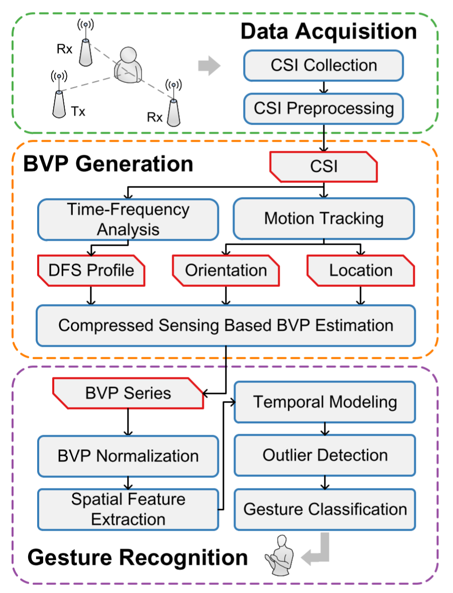

Literature review
Two Functions
CNN extracts high-level spatial features within each BVP using convolutional layers
CNN adopts recurrent layers to perform temporal modeling of inter-characteristics between BVPs

Slide 7
Significance and novelty

Slide 8






Significance and novelty
---- mobility of time
The value of Wi-Fi signal can vary at different times of day
the number of devices connected to the network
Widar 3.0: Train on the same day and test on the same day
Problem: NOT consider and account for these variations
the distance between the device and the router
Our model: Train and test at different times
interference from other devices or networks
Advantage: mobility of time

Slide 9
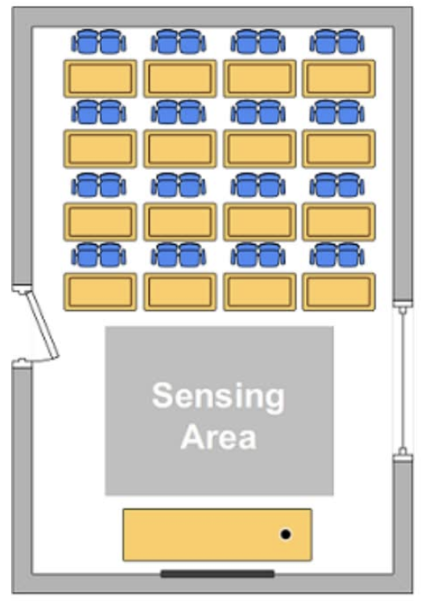
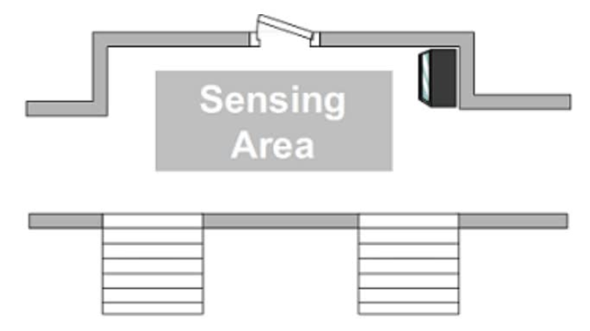
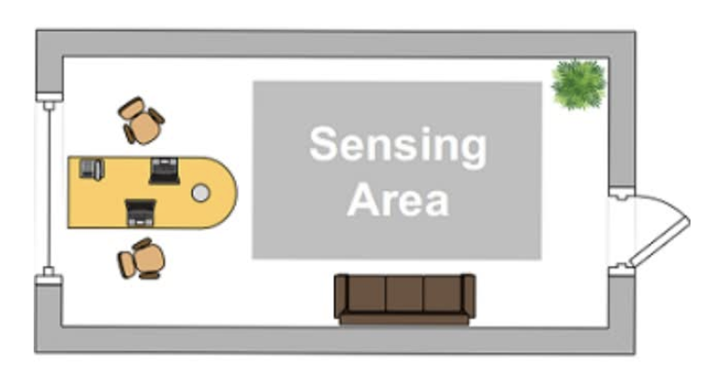
Significance and novelty
---- efficient training on diverse domains
CNN (Widar)
----cross-place domains
MAML-DG (Our model)
----cross-time domains
Room 1: Classroom
Room 2: Hall
Room 3: Office
MAML can train a model that is agnostic to these domain-specific differences

Slide 10



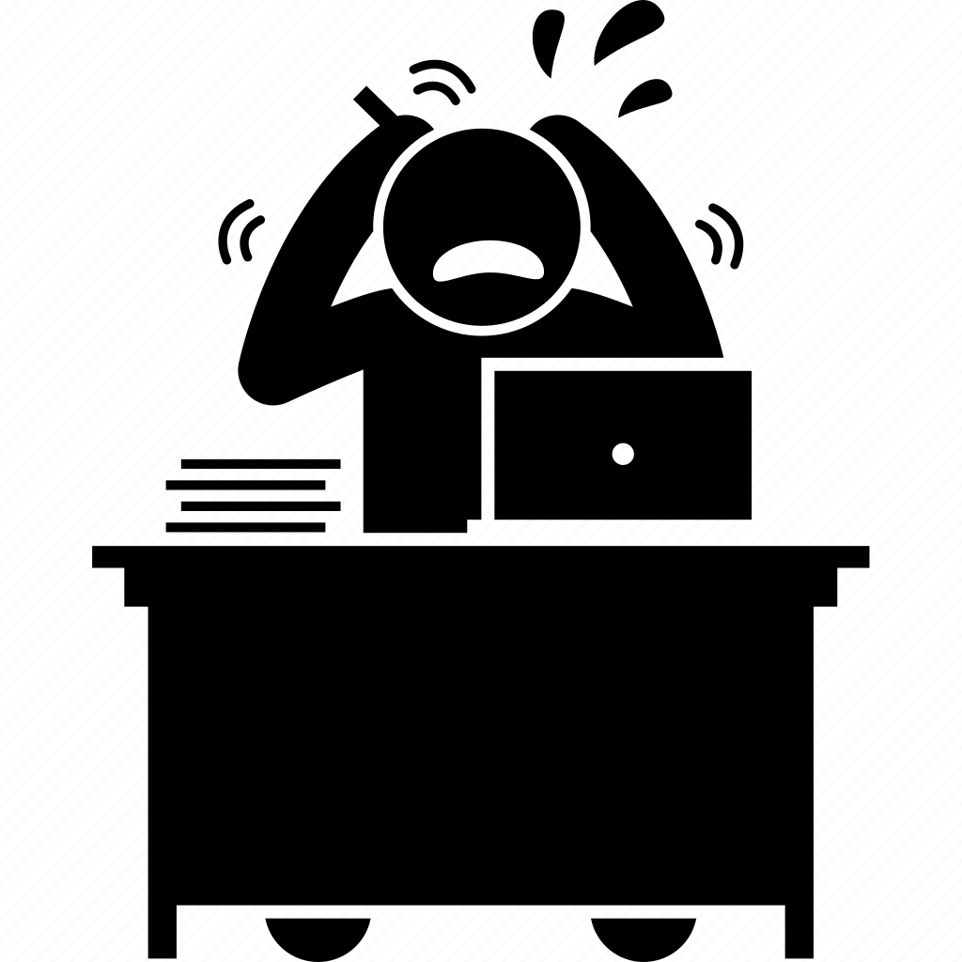

Significance and novelty
---- perform well with limited data in a new environment
New environment
CNN (Widar 3.0)
MAML
The number of steps for fine-tuning is large
The accuracy is low
Only THREE data points are enough for a new environment
Faster convergence and higher accuracy

Slide 11
Algorithm

Slide 12
What is a task?
TASK
N different labels
K different samples in one label
N way
K shot
Support Set
Query Set

Slide 13
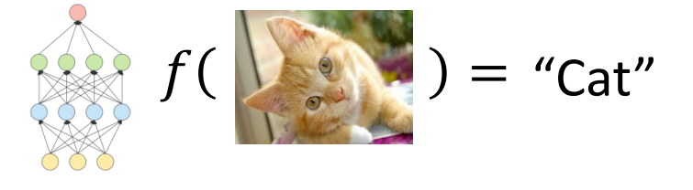
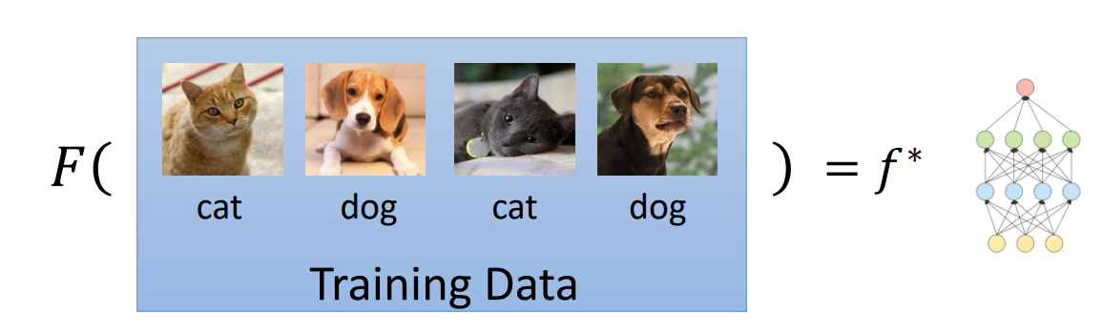
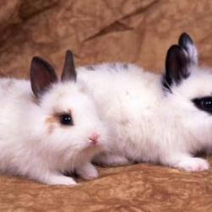
Meta Learning
Machine Learning
Finding a function f according to the given dataset
Finding a function F that can quickly adapt to different test tasks
Meta Learning

Slide 14
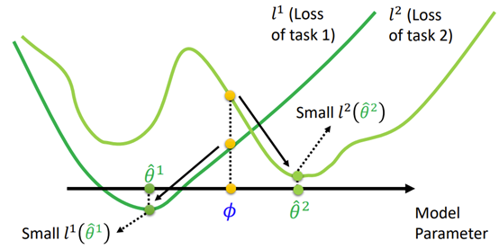

Algorithm ----MAML
Goal: To learn parameters that can rapidly converge to global minimum of a new test task

Slide 15
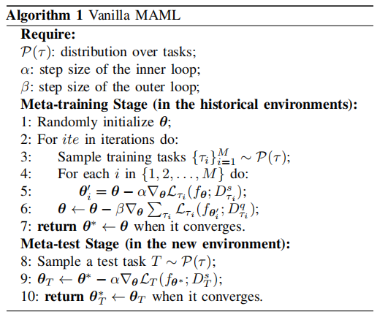
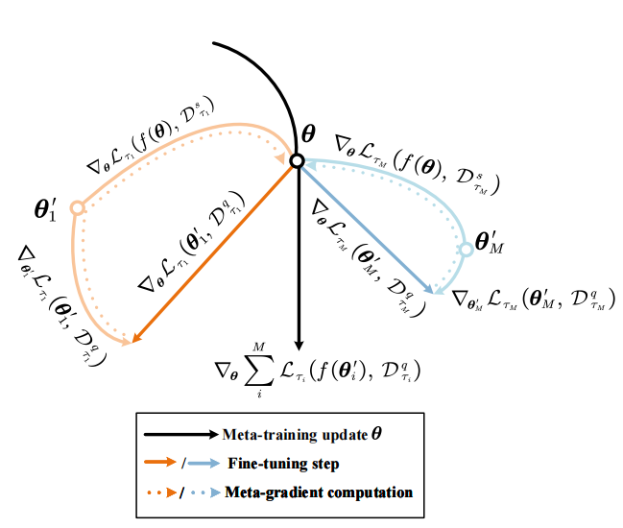
Algorithm ----MAML
Outer
inner
C. Finn, P. Abbeel, and S. Levine, “Model-agnostic meta-learning for fast adaptation of deep networks,” in Proc. Int. Conf. Mach. Learn., 2017, pp. 1126–1135.

Slide 16
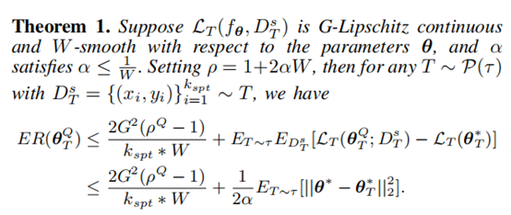
Theoretical Guarantee for MAML
Reference:
P. Zhou, Y. Zou, X.-T. Yuan, J. Feng, C. Xiong, and S. Hoi, “Task similarity aware meta learning: Theory-inspired improvement on MAML,” in Proc. Uncertainty Artif. Intell., 2021, pp. 23–33.

Slide 17
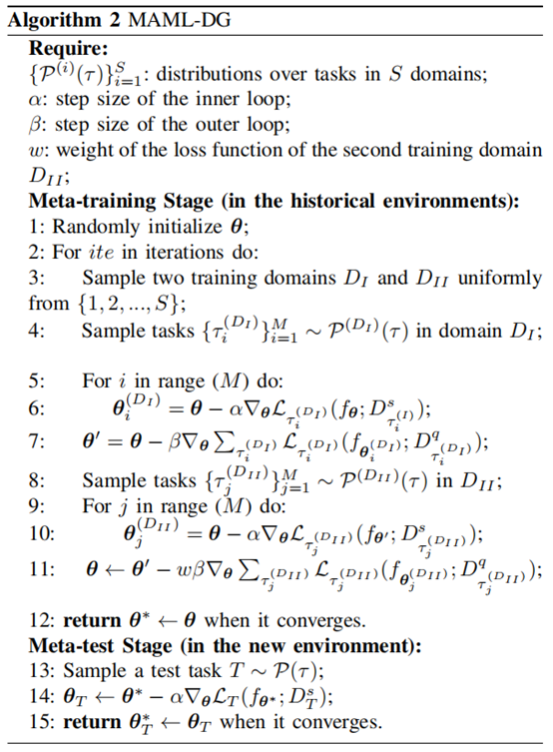
Algorithm ----MAML-DG
Idea: Mimic the real train-test domain shift
1-3:
Randomly pick out two training domains
4-7:
Virtually train a θ’ through an entire MAML algorithm based on the first domain
8-10 (Mimic the real train-test domain shift):
Treat θ’ as the initialization of the second domain;
Do the fine-tuning on the second domain;
Derive the loss L
By minimizing L, we have guaranteed that the learned θ* can converge to a new test domain very quickly

Slide 18
Our Experiments:
Training-task format: 3-way; 2-shot for support set; 3-shot for query set
Test-task format: 5-way; 3-shot for support set; 5-shot for query set
Dataset:
CSI images with size 50*50;
The number of labels: 75
The number of environments (dates): 6
Training and Test Procedure:
To test on tasks from date A, we use the data from all other dates for training. Then for the test task from date A, we use its support set containing only 3 samples for each label to do the fine-tuning, and then use its query set containing 5 samples for each label to test the accuracy.

Slide 19
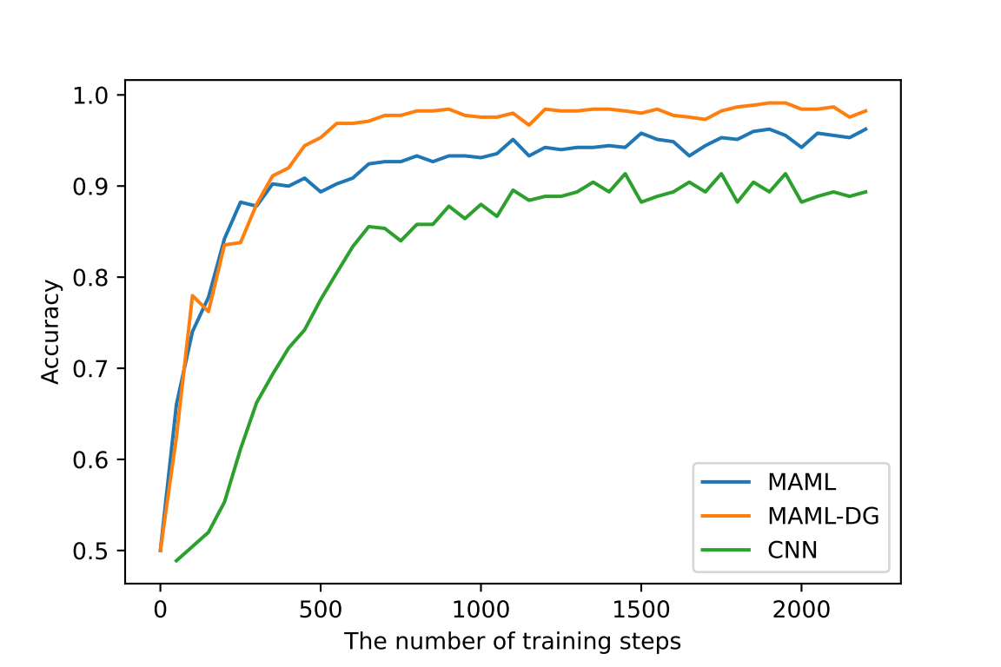
Results:
MAML-DG demonstrates the best performance (accuracy: >95%)
MAML is inferior to MAML-DG, but the accuracy is still high
The performance of CNN is the worst
CNN requires larger training steps to converge
(Here we did the fine-tuning to CNN on a large amount of data!)
Figure 1

Slide 20
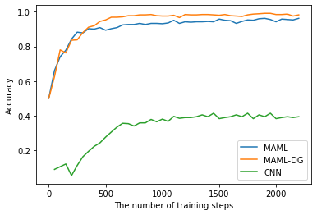
Results:
The CNN is fine-tuned on only 3 data points per label
(MAML and MAML-DG are also fine-tuned with 3 data points per label)
Figure 2

Slide 21
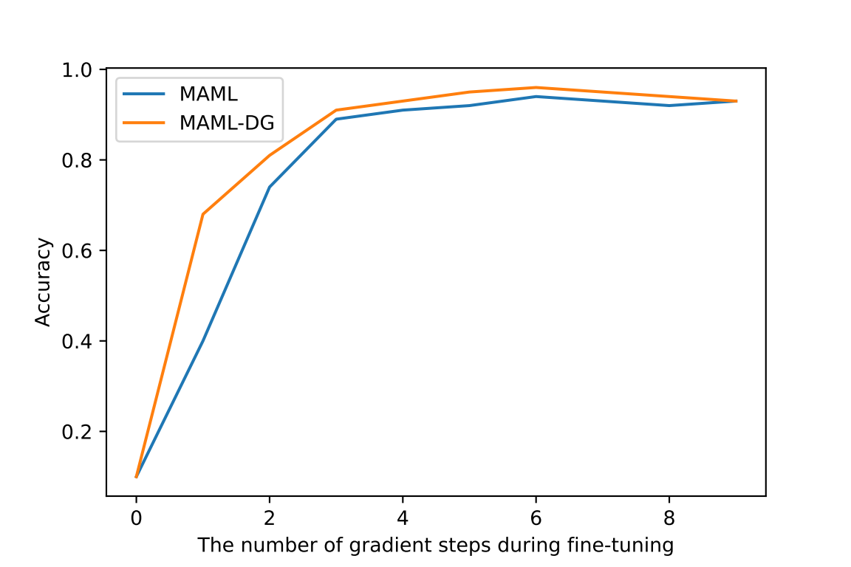
Results:
MAML and MAML-DG require only 4 gradient steps during fine-tuning to achieve satisfactory accuracy
MAML-DG can achieve faster convergence compared to MAML
Figure 3

Slide 22
Summary of the results
1. Our model demonstrates exceptional environmental adaptation abilities
——eliminates the need of human efforts in a new testing environment
2. MAML-DG, is proved to achieve even faster adaptation and better accuracy than MAML.

Slide 23
Conclusion

Slide 24
Contributions
1. Applied MAML to the Widar dataset——perform well in different environments with minimal fine-tuning data
2. Developed MAML-DG, which requires fewer training steps to converge and achieves better adaptation abilities than the original MAML algorithm
3. Promising prospects! (e.g., smart homes, virtual gaming, and health monitoring)

